Slide 1


Predictive Maintenance in Solar Power Systems

Slide 2
Content
Abstract
Problem Statement
Objective
Data Collection and Preparation
Proposed Solution (Methodology)
Model Performance Evaluation
Screenshots / Demonstration (video)
Future Scope
Conclusion
Notes:
Abstract
Problem Statement (Clearly define the challenge)
Objective (State your project's goal)
Background and Research (Discuss existing solutions, trends, and gaps)
Data Collection and Preparation (Focus on data sources, cleaning, and augmentation)
Proposed Solution (Methodology)
Model Architecture (e.g., CNN, U-Net, YOLOv5)
Key Techniques (e.g., Transfer Learning, Image Augmentation)
Model Performance Evaluation
Metrics (Accuracy, Precision, Recall, IoU, etc.)
Graphs (Confusion Matrix, ROC Curve, etc.)
Screenshots / Demonstration (Visual proof of system functionality)
Future Scope (Improvements, scalability, and integration ideas)
Conclusion (Summarize results and impact)
Q&A Session

Slide 3
Abstract
Predictive maintenance leverages machine learning to detect potential failures in solar power systems.
It minimizes downtime, optimizes efficiency, and reduces maintenance costs.
This approach minimizes downtime and extends the lifespan of solar equipment.
This project implements a Random Forest model to predict inverter failures.

Slide 4
Problem Statement
Solar power systems experience component degradation over time.
Unplanned failures lead to power loss and increased operational costs.
Traditional maintenance methods are reactive and inefficient.
Need for an AI-driven predictive approach to ensure reliability.

Slide 5
Objective
Develop a machine learning model to predict inverter failures.
Identify key features that influence failures.
Implement data preprocessing techniques for improved model accuracy.
Evaluate model performance using appropriate metrics.
Improve maintenance strategies to reduce unexpected downtimes.

Slide 6
Data Collection and Preparation
Dataset: Collected sensor data from solar inverters
Key Features:
- Temperature (°C)
- Voltage (V)
- Current (A)
- Failure status (Target Variable)
Preprocessing Steps:
- Removed unnecessary columns (e.g., timestamp).
- Standardized features using StandardScaler.
- Addressed class imbalance using oversampling.

Slide 7
Proposed Solution (Methodology)
1.Data Preprocessing: Feature selection, Standardization, Class balancing
2. Model Selection: Random Forest Classifier.
3. Training & Testing: 80/20 data split.
4.Feature importance analysis identifies Voltage and Current as key predictors.
5. Evaluation Metrics: Accuracy, Precision, Recall, F1-score
.

Slide 8
Model Performance Evaluation
• Results after training on balanced data:
- Accuracy: 0.09%
- Precision: 0.84%
- Recall: 1.00%
- F1 Score: 0.91%
• Feature Importance: Voltage and Current are most influential.
• Visualization: Failure probability vs. actual labels.

Slide 9
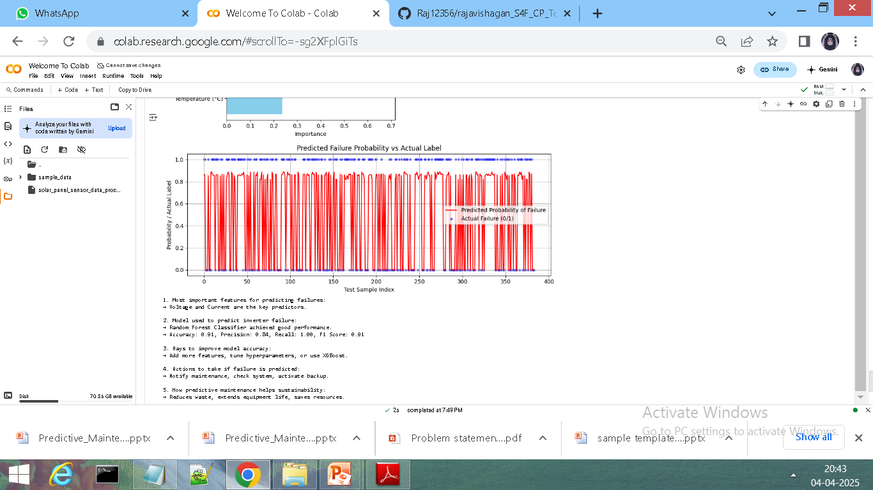
Screenshots / Demonstration (video)
https://colab.research.google.com/#scrollTo=-sg2XFplGiTs
https://github.com/Raj12356/rajavishagan_S4F_CP_Team_12241/tree/main

Slide 10
Future Scope
Hyperparameter tuning for improved accuracy.
Exploring advanced ML models like XGBoost and Neural Networks.
Real-time deployment on embedded systems.
Integration with IoT sensors for automated monitoring.
Extend predictive maintenance to other renewable energy systems.

Slide 11
Conclusion
Predictive maintenance helps reduce system failures and improve efficiency.
Machine learning models effectively identify patterns in solar system failures.
Future improvements will make the system more robust and scalable
mplementing AI-based maintenance can increase the reliability of solar energy.

